Slide 1
Verilog to Routing (VTR): A Flexible Open-Source CAD Flow to Explore and Target Diverse FPGA Architectures
Vaughn Betz
With thanks to all VTR contributors, and particularly Kevin Murray for assistance in creating this presentation

Slide 2
Agenda
FPGAs: Basics & Utility
Flexible CAD: Motivation and Challenges
Verilog to Routing: Recent Progress
Architecture Generality
AIR: Faster, More Adaptive Routing
VTR 8.0: QoR Improvements
Reinforcement Learning for Adaptive Placement
Summary

Slide 3
FPGA Basics & Utility

Slide 4
FPGA Basics
Programmable Hardware
Can implement arbitrary circuits
Look-Up Table (LUT) implements logic
Flip-Flop (FF) stores sequential state

Slide 5
FPGA Basics
Logic Block (LB)
Group of Logic Elements (LEs)
…

Slide 6

FPGA Basics
Device
Grid of Function Blocks
Interconnect
Routing Switch
IO
LB
RAM
LB
LB
LB
DSP
LB
IO
LB
RAM
LB
LB
LB
DSP
LB
IO
LB
RAM
LB
LB
LB
DSP
LB
IO
LB
RAM
LB
LB
LB
DSP
LB

Slide 7
FPGA Basics
HDL
Mapping Applications to an FPGA
Modern FPGAs are large (>10M LEs)
Use Computer Aided Design (CAD) flow!
Designer: provides behavioural specification
Algorithms & tools: figure out the details
Logic Synth.
Tech. Map
Pack
Place
Route
Bitstream

Slide 8
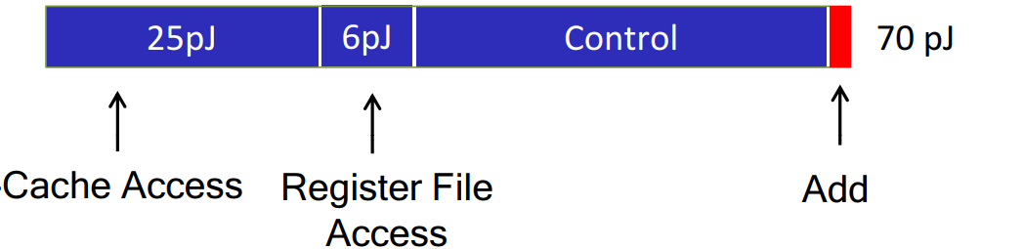
Why Use an FPGA?
Flexible I/O
No off-the-shelf chip with right I/O
Power Efficiency
CPU/DSP/GPU performance per watt too low
Programmability
Dedicated ASIC not practical (e.g. changing workload)
45 nm CPU energy breakdown [1]
0.03 pJ for 8-bit int add
0.90 pJ for 32-bit fp add
[1] M. Horowitz, “Computing’s Energy Problem,” ISSCC, 2014.

Slide 9

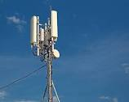
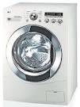
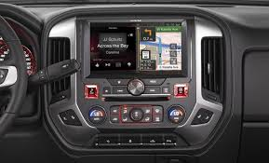
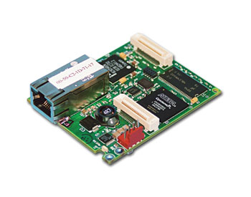
Widely Used Across Many Domains
CAD flow key to success

Slide 10
Flexible, Open Source CAD: Motivation and Challenges

Slide 11
I: FPGA Architecture Research
Challenges:
Need representative benchmarks
Describe FPGA Architecture
Need high quality CAD flow
Benchmarks
FPGA Architecture #1
FPGA Architecture #2
Need CAD Flow for Architecture #1
Need CAD Flow for Architecture #2
Speed/Area/
Power
Speed/Area/
Power

Slide 12
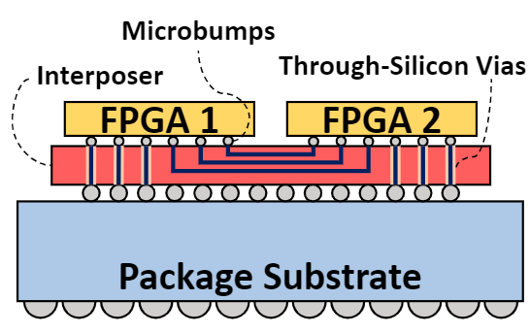
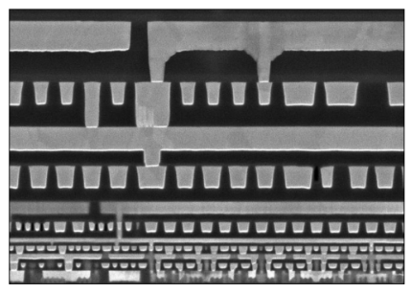
Why New FPGA Architectures?
Process Technology Changes
Wire resistance, power limits, interposers, …
2. Application Changes
New standards, faster processing: 4G → 5G, …
Deep Learning → new compute demands
Embedded FPGAs
3. Innovative Architecture Ideas!
(12)
CPU
Video
MEM
FPGA
Vision

Slide 13
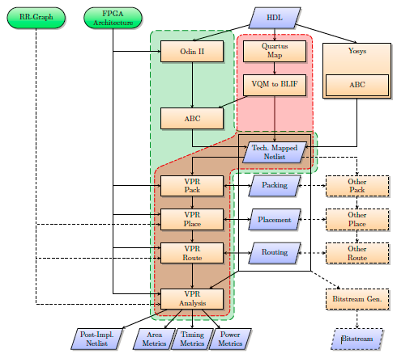
II: FPGA CAD Research
New idea for CAD algorithm
Need infrastructure!
Do not build it all
Focus on your contribution
Common framework:
Best practise
Compare results
Flexible CAD: more impact
VTR enhancements help Symbiflow (QuickLogic EOS S3, Xilinx Artix7), start-ups, architecture research, …

Slide 14
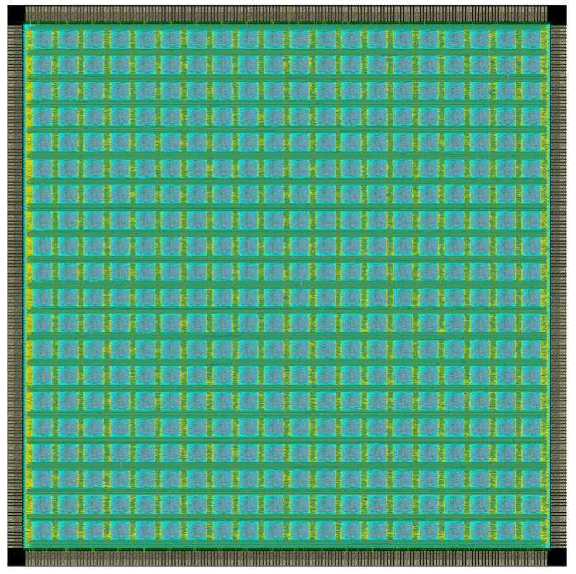
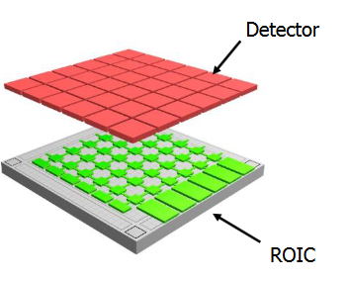
III: Program Novel Spatial Compute Architectures
Have an architecture? Build it!
FPGA/FPGA+???/???
Need a CAD flow!
Custom FPGA
ReImagine: FPGA + Imager
(MIT Lincoln Lab) [1]
OpenFPGA (U of Utah) [2]
PRGA (Princeton) [3]
[1] https://www.darpa.mil/attachments/Final_Compiled_ReImagineProposersDay.pdf
[2] OpenFPGA: a Complete Open Source Frameworkfor FPGA Prototyping, Open Source Design Automation, 2019 (https://sites.google.com/site/pegaillardon/research/openfpga)
[3] PRGA: An Open-source Framework for Buildingand Using Custom FPGAs, Open Source Design Automation, 2019 (https://prga.readthedocs.io)

Slide 15
VTR: Verilog to Routing

Slide 16
Verilog to Routing (VTR) Project
Architecture
Verilog
ODIN II
Open Source FPGA CAD Flow
Approach:
Architecture Agnostic
Data-driven FPGA Architecture description
ABC
Netlist
VPR
Pack
STA
Place
Route
Analysis
QoR

Slide 17
VTR Challenges
Explore larger design space
Architecture
Generality
Quality
Run-time
Accurate architecture conclusions
Reduces designer effort
Can take hours to days (for large designs)
Can we have all three?

Slide 18
Outline
Architecture
Verilog
1
VTR 8 Capabilities & New Features
ODIN II
1
ABC
AIR: Adaptive Incremental Router
Netlist
2
VPR
Pack
STA
VTR 8 QoR, Run-time & CAD Enhancements
3
Place
4
Route
2
Reinforcement Learning Enhanced Placement
Analysis
4
3
QoR

Slide 19
Outline
Architecture
Verilog
1
VTR 8 Capabilities & New Features
ODIN II
1
ABC
AIR: Adaptive Incremental Router
Netlist
2
VPR
Pack
STA
VTR 8 QoR, Run-time & CAD Enhancements
3
Place
4
Route
2
Reinforcement Learning Enhanced Placement
Analysis
4
3
QoR
K. E. Murray, et al., “VTR 8: High Performance CAD and Customizable FPGA Architecture Modelling", ACM TRETS, 2020

Slide 20
Block Modeling
6-LUT
+
4-LUT
?
Logic Primitive
Logic Element
Logic Block Size
Supports both soft & hard blocks
Arbitrary:
Netlist Primitives
Hierarchy
Connectivity
Inter-Element Connectivity

Slide 21
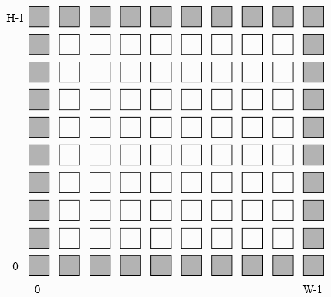
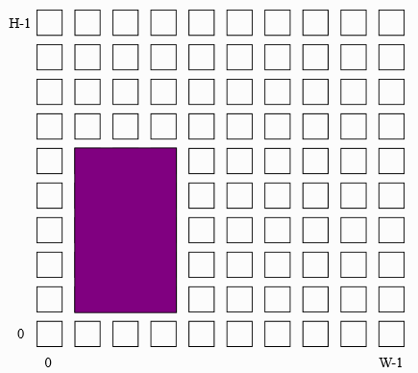
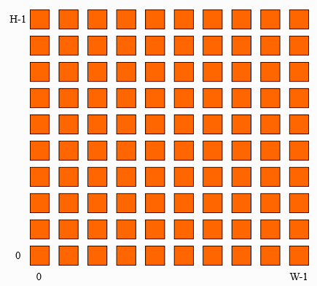
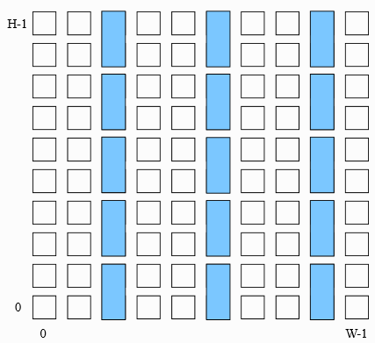
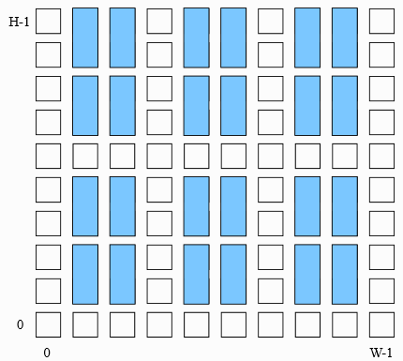
General Device Grids
New!
Perimeter
Single
Fill
Column
Region

Slide 22
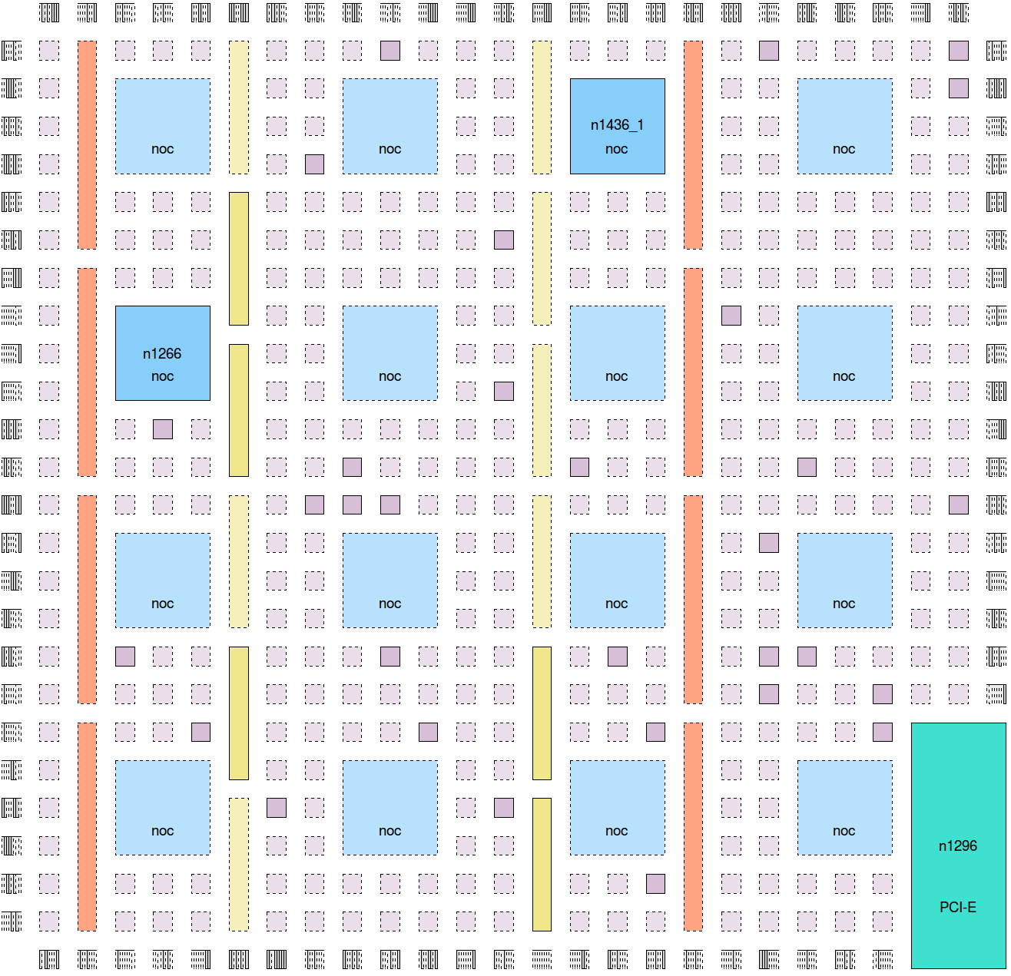
Arbitrary Grid Example
New!
IOs
Logic Block
NoC
Router
DSP
Block RAM
Hard
Block

Slide 23
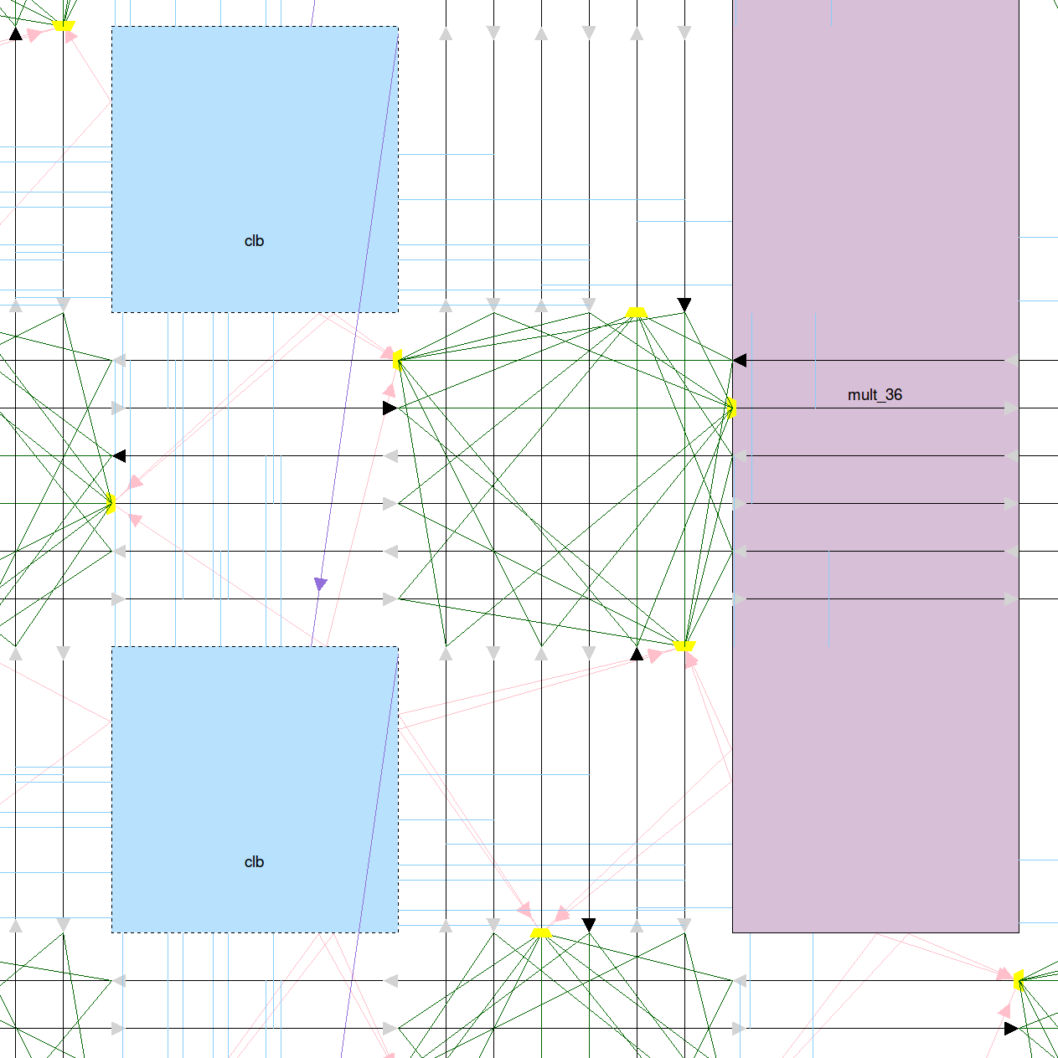
Detailed Routing Architecture
Block Input Connection
Direct Block-Block Connection
Routing
Wires
Wire-Wire Connections
(switch-block)
Block Output Connection

Slide 24
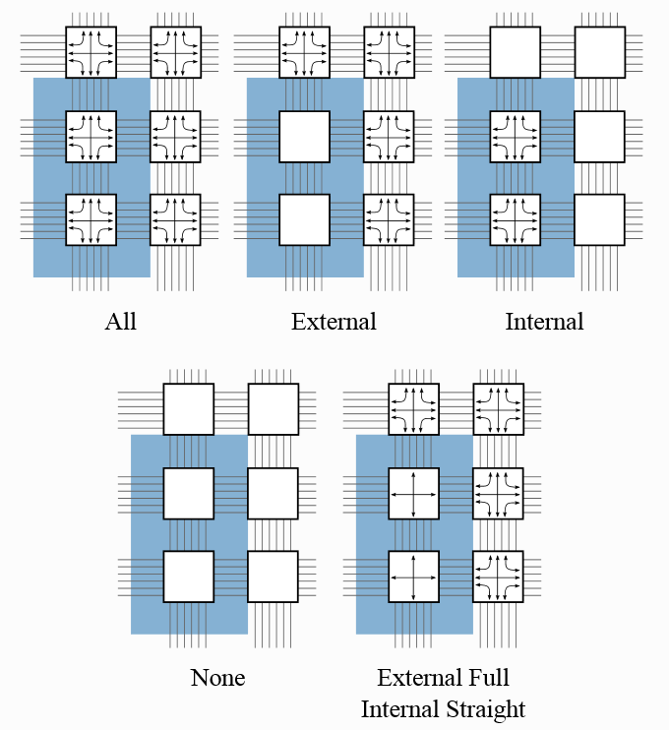
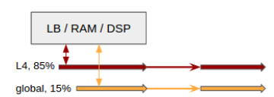
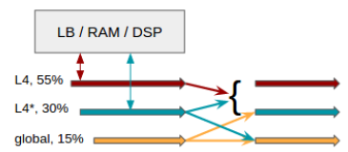
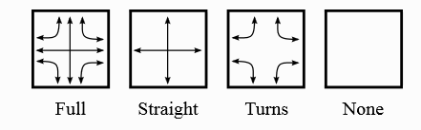
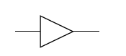
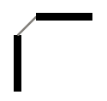
Customizable Routing Architectures
New!
Switch-block Locations
Wire Connectivity
Non-Configurable Edges
Notes:
Custom SB: Oleg Petelin – data-driven architecture description
SB Locations: Large processor using all metal layers, shorted wires over hard block (e.g. RAM)
Non-config edges: Buffers (clock networks), L/T wires (Xilinx, Academic) – keep common case simple, elegant extension via non-configurable

Slide 25
Fully Custom Routing Architectures
New!
RR
Graph
Load RR graph from file
VPR or non-VPR generated
Full control of routing network
Allows freezing RR graph (e.g. taped-out)
Arch.
Verilog
ODIN II
ABC
Netlist
VPR
Pack
STA
Place
Route
Analysis
QoR
Notes:
Researchers & companies have taped out chips, used VTR as CAD system – must match chip!

Slide 26
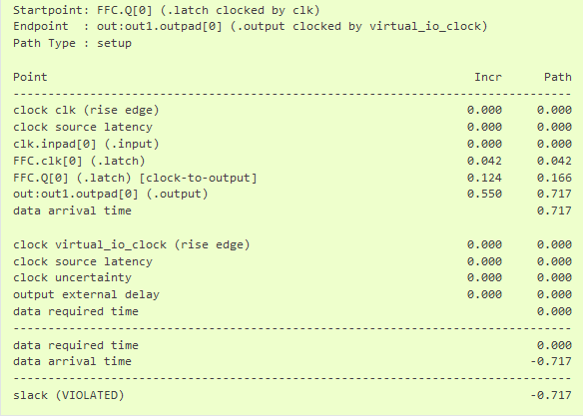
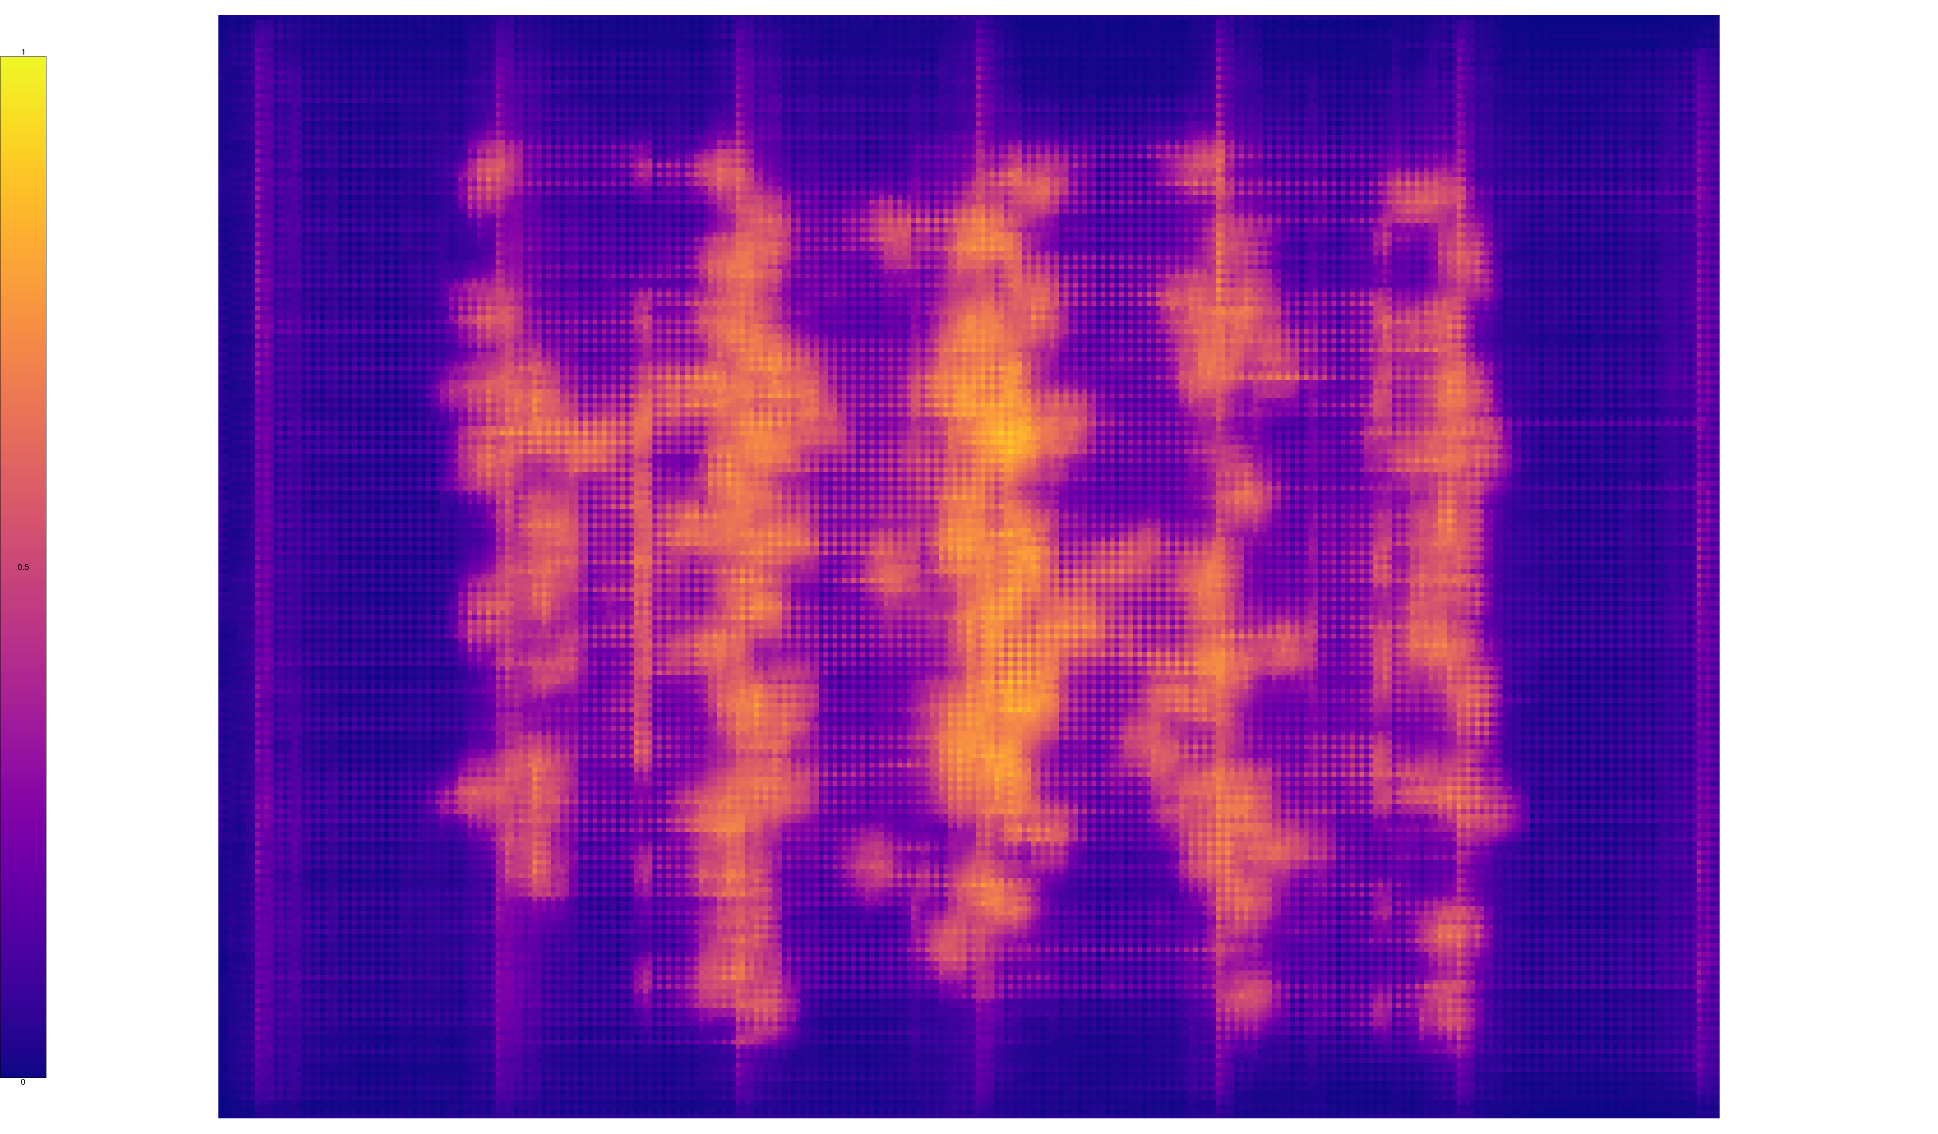
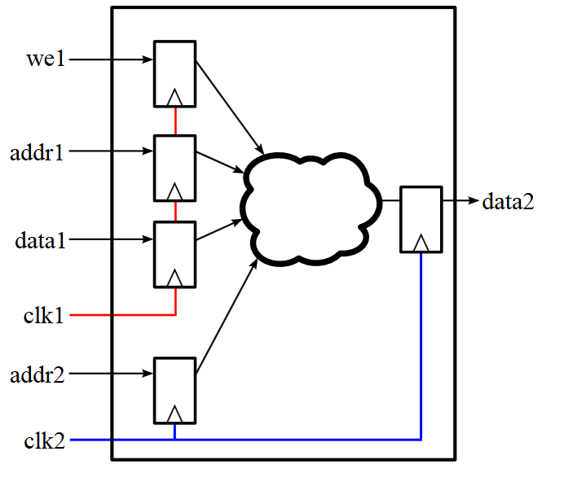
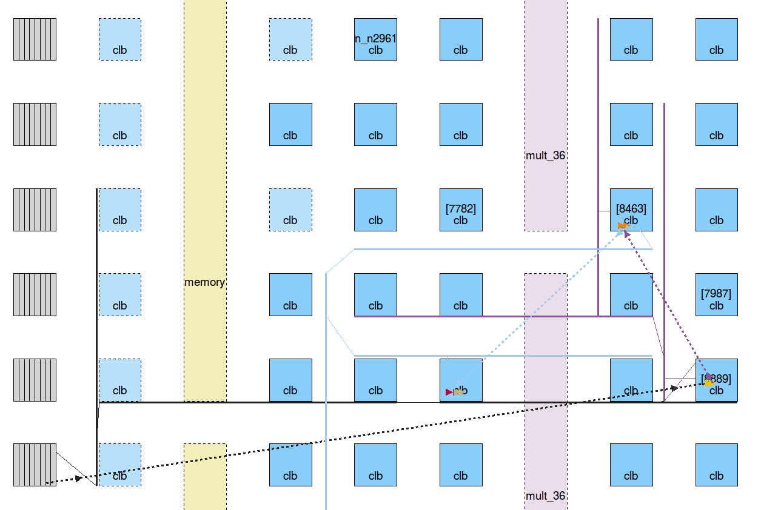
Analysis & Modeling
New & Enhanced!
Run analysis independent of optimization
Improved visualizations & reporting
Improved area models
Full featured timing analysis
Min & max timing models
Multi-clock primitives
Timing Reports
Multi-clock Primitives
Routing Utilization
Critical Path

Slide 27
Outline
Architecture
Verilog
1
VTR 8 Capabilities & New Features
ODIN II
1
ABC
AIR: Adaptive Incremental Router
Netlist
2
VPR
Pack
STA
VTR 8 QoR, Run-time & CAD Enhancements
3
Place
4
Route
2
Reinforcement Learning Enhanced Placement
Analysis
4
3
QoR
K. E. Murray, et al., "AIR: A Fast but Lazy Timing-Driven FPGA Router", ASP-DAC, 2020, 1-7.

Slide 28
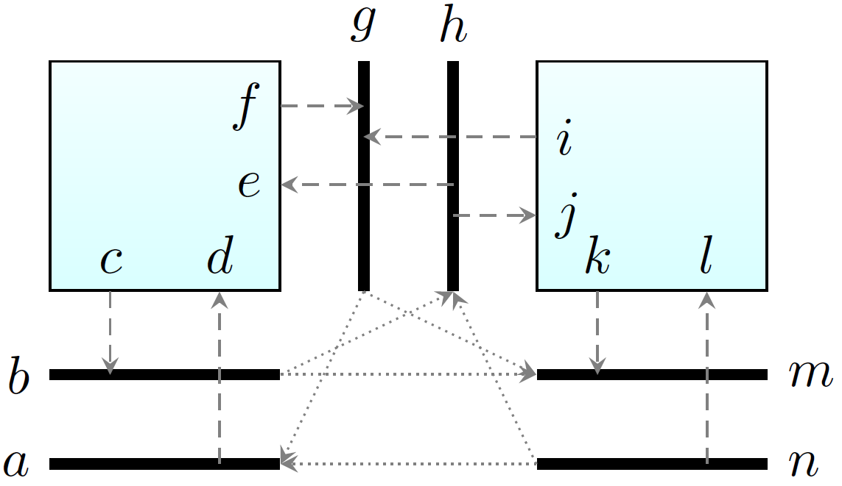
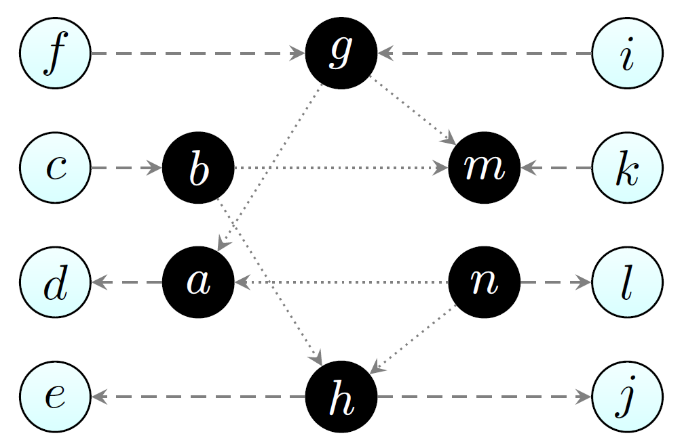
FPGA Routing Problem
Model interconnect network as Routing Resource (RR) graph:
Nodes: Conductors (wires/pins)
Edges: Configurable switches
FPGA Routing Problem:
Find embedding of netlist in RR graph
Requires finding many non-overlapping trees in RR graph
Minimize timing and wiring (power)
Reasonable run-time
Usually solved as single combined global/detailed routing stage
Routing Architecture
Routing Resource (RR) Graph
Notes:
Run-time: FPGAs have ‘instant’ manufacturing, makes CAD run-time very critical!

Slide 29

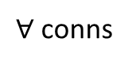
Negotiated Congestion Routing
Allow multiple nets to use same resources (congestion)
Nets negotiate for resources
Nets do not block each other
Re-route
Net Router
Connection Router
$∀$ conns
$∀$ nets
Legal?
Yes
Done!
No
Rip-up Nets
Increase Cong. Costs
Congested!
Congestion Free!
Notes:
Single stage:

Slide 30
AIR: Adaptive Incremental Router
Negotiated congestion router
Adaptive Routing
Lazy Routing
Improve quality & robustness
Avoid unnecessary work!

Slide 31
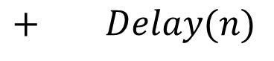
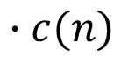
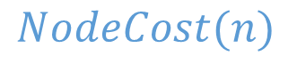
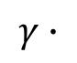
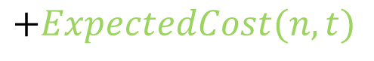
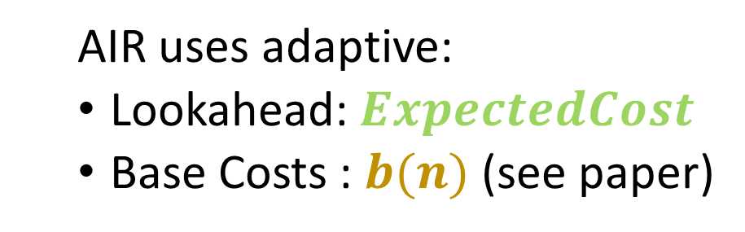
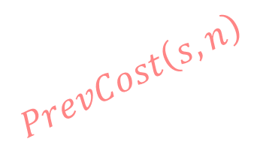

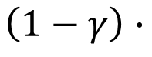
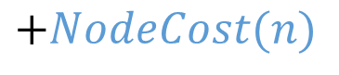


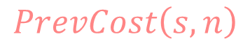
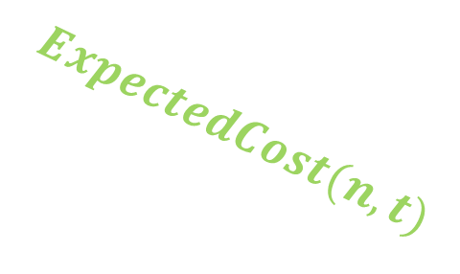
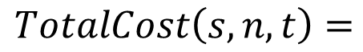
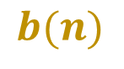
Connection Router: Architecture Adaptation
$$TotalCost\left(s,n,t\right)=$$
$$PrevCost\left(s,n\right)$$
$$+NodeCost(n)$$
$$+ExpectedCost(n,t)$$
Re-route
$$PrevCost\left(s,n\right)$$
n
$$ExpectedCost(n,t)$$
Net Router
$$NodeCost(n)$$
Connection Router
$∀$ nets
S
$∀$ conns
t
Congestion Cost
Legal?
Yes
Done!
No
$$NodeCost\left(n\right)=$$
$$\left(1−γ\right)∙$$
$$b(n)$$
$$∙c(n)$$
$$γ∙$$
$+ Delay(n)$
Rip-up Nets
Base Resource Cost
Timing
Criticality
Increase Cong. Costs
AIR uses adaptive:
Lookahead: $ExpectedCost$
Base Costs : $b(n)$ (see paper)

Slide 32
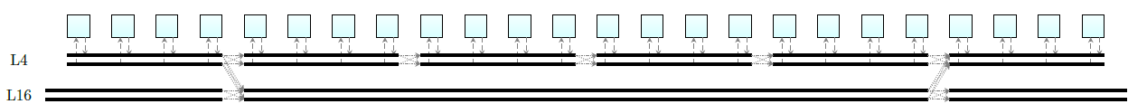
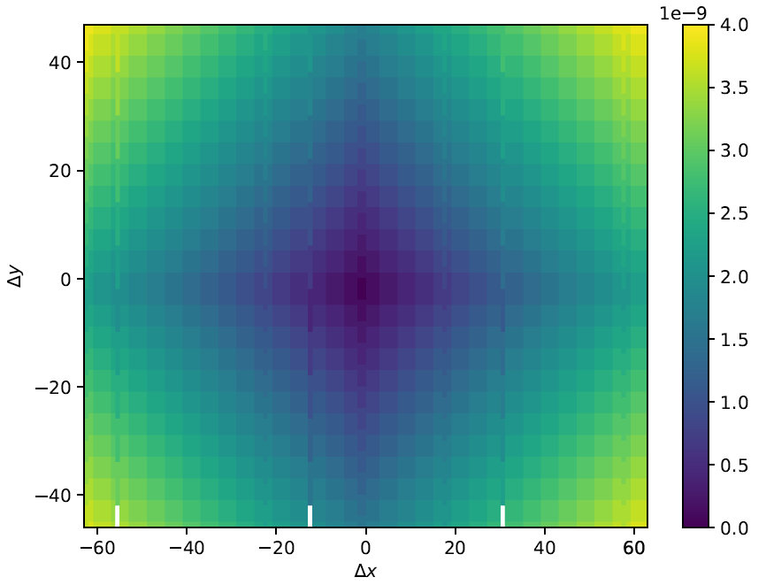
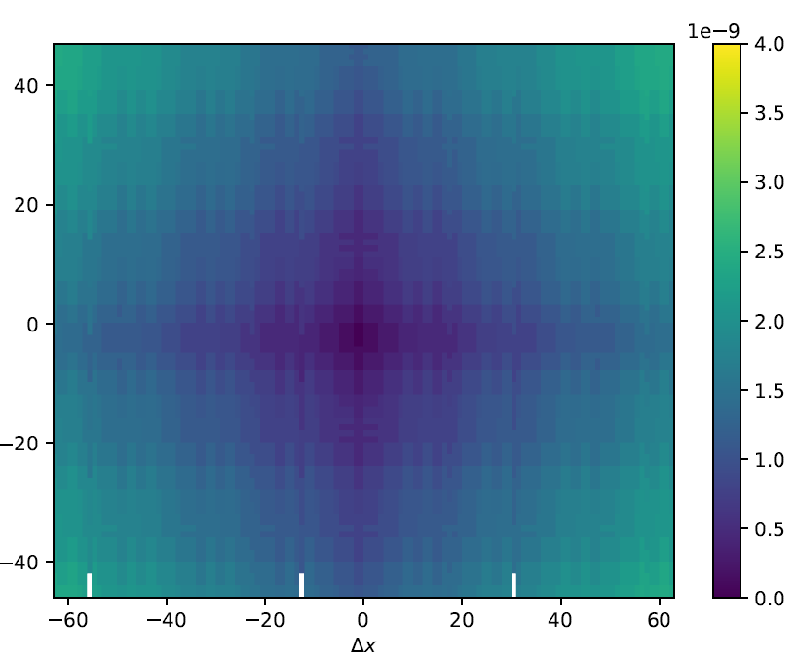
Adaptive Lookahead
Observation: Lookahead should adapt to routing architecture
Challenges:
Many FPGA Architectures
Huge Graph
Reasonable build time
Fast evaluation
Approach:
Profile graph with un-directed Djikstra flood & automatically data reduce
Adapts to graph
More accurate → faster for equivalent/better quality
Classic Lookahead Delay
Map Lookahead Delay
Lower delay

Slide 33
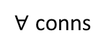
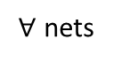
Net Router: Lazy Routing
Re-route
Net Router
AIR Routes Nets Lazily:
Efficiently handle High-Fanout nets
Incrementally re-route congested nets
Connection Router
$∀$ conns
$∀$ nets
Legal?
Yes
Done!
No
Rip-up Nets
Increase Cong. Costs

Slide 34
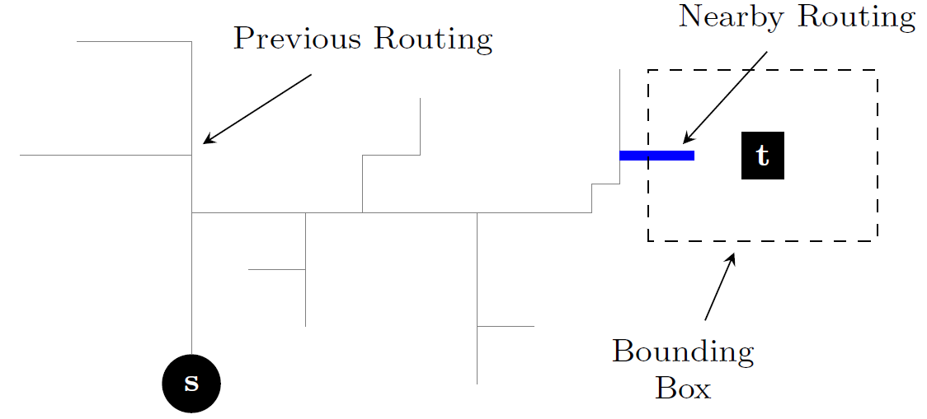
High-Fanout (HF) Routing
Observation: Most routing of HF net irrelevant for a particular sink
But still consider as potential branch points (expensive)
Optimization:
Only consider branch points spatially nearby target
Don’t even look at others
Limit search to region near target

Slide 35
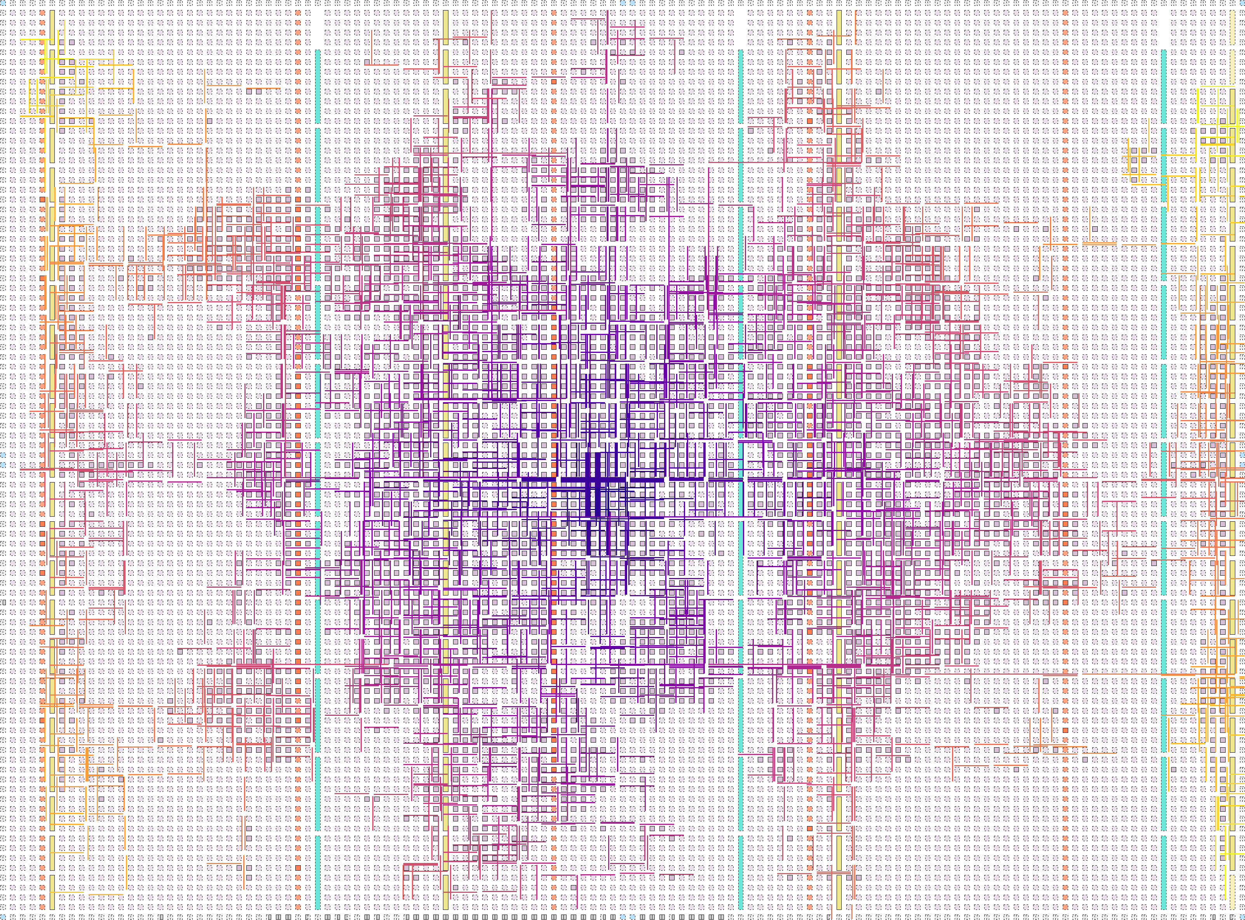

HF Router Expansion
Traditional
Spatial Lookup
Notes:
Visualizing nodes explored (total cost) while routing HF net connection. Color proportional to cost.
Small neuron benchmark, ~3500 fanout net

Slide 36

Incremental Routing
Observation: Most net connections routed legally
Optimization:
Rip-up illegal sub-trees
Re-route only those sub-tree connections
A
A
A
B
C
Rip-up
B
C
Re-route
B
C
D
E
F
D
F
D
I
F
G
H
G
H
G
H
Challenge: May degrade critical path
Fix: Also rip-up delay sub-optimal connections

Slide 37
Evaluation Titan Flow & Benchmarks
Titan Flow:
Synth. & Tech-Map with Quartus
Pack/Place/Route with Quartus or VPR
Titan Benchmarks:
Target Stratix IV
23 designs, 90K-1.9M primitives
Academic Routers:
VPR 7
CRoute
AIR
Commercial Routers:
Intel Quartus 18.0
Stratix IV Model
Verilog
Quartus
Map
Netlist
VPR
Pack
STA
Quartus
Fit
Place
Route
Analysis
QoR
QoR
Notes:
Scott Whitty

Slide 38
AIR Outperforms Academic Routers
> 6.6x run-time reduction
Incr. Routing
HF Routing
Lookahead
19% faster critical path
Lookahead
15% less
wiring
Resource Base Costs
Lookahead
Notes:
CRoute: Decomposes nets into indep. Connections
AIR: Incremental approach, still exploits net structure
Versus CROUTE:
2x run-time reduction
17% faster CPD
5% WL

Slide 39
AIR is Faster than Quartus
4x run-time reduction
Gap due to lower quality placement

Slide 40
AIR Effectively Resolves Congestion
Critical Path not degraded
Wiring reduced
Notes:
Cong. Obliv: All connections timing critical, all get best timing, all use as much wire as needed
No change in CPD, 14% WL reduction (non-critical re-routed for WL)

Slide 41
Outline
Architecture
Verilog
1
VTR 8 Capabilities & New Features
ODIN II
1
ABC
AIR: Adaptive Incremental Router
Netlist
2
VPR
Pack
STA
VTR 8 QoR, Run-time & CAD Enhancements
3
Place
4
Route
2
Reinforcement Learning Enhanced Placement
Analysis
4
3
QoR
K. E. Murray, et al., “VTR 8: High Performance CAD and Customizable FPGA Architecture Modelling", In submission to ACM TRETS, 2020

Slide 42

Titan Benchmark Completion
Tool | Routed Benchmarks | Unroutable Benchmarks | Device Too Small
VTR 7 | 14 | 9 | -
VTR 8 | 23 | 0 | -
Quartus 18.0 | 20 | 1 | 2
VTR 8 Titan Benchmark Implementations

Slide 43



Packing & Placement Enhancements
Avoid highly interconnected (unnatural) clusters
Avoid packing unrelated logic
Include more indirect (e.g. transitive) connectivity measures
De-prioritize high-fanout nets
Unclustered
Clustered with Unrelated Logic
Naturally Clustered
Improved Placement Exploration
Better macro/carry-chain swapping
Improved swapping of sparse blocks
VTR 7
VTR 8
des90 Routing Utilization

Slide 44
VTR 8 Run-time & Memory Footprint
Quartus 18.0
% Total
7.2%
78.0%
9.8%
100.0%
Run-time & memory comparable to commercial tools
2.4%

Slide 45
VTR 8 QoR
Quartus 18.0
Quality in the range of commercial tools

Slide 46
Outline
Architecture
Verilog
1
VTR 8 Capabilities & New Features
ODIN II
1
ABC
AIR: Adaptive Incremental Router
Netlist
2
VPR
Pack
STA
VTR 8 QoR, Run-time & CAD Enhancements
3
Place
4
Route
2
Reinforcement Learning Enhanced Placement
Analysis
4
3
QoR
K. E. Murray and V. Betz, “Adaptive FPGA Placement Optimization via Reinforcement Learning", MLCAD, 2019

Slide 47
Reinforcement Learning & CAD

Slide 48
CAD Tool Development: Human-in-the-loop
Large solution space → Use heuristics
Evaluate
Idea
Tool
Tune
With human-in-the-loop:
Slow
Simple heuristics, limited tool parameters (to keep tractable)
Tune for average case (can’t investigate every benchmark design)

Slide 49

CAD Tool Development: Reinforcement Learning (RL)
Tool
Reward
Idea
Tool
Learn
Act
With RL:
Human out of the loop!
Learn better heuristics: exploit more information, more parameters
Online adaptation → better than average case
Notes:
Not auto-tuner, can be deeper within the tool

Slide 50
FPGA Placement

Slide 51
Simulated Annealing (SA) Placement
Logic
DSP
RAM
Modify placement by making ‘moves’
Accept/Reject move based on:
Cost change
Temperature (hill climbing)

Slide 52
Move Generation
Many possible types of moves!
Simple: random swap
Smart: directed move to ‘good’ location (wirelength, timing)
Complex: Analytic
Complex: Assignment
Many considerations:
Frequencies of different moves
Situation dependent?
Move ‘strength’ vs run-time
Treat as RL Problem!
Notes:
SA as framework for bucket of algorithms (SA as true meta-heuristic)
Situation dependent:
* Early/Late placement
* Circuit structure

Slide 53

RL Move Generator
Action/Move
Actions: moved different block types
Reward:
Accepted: -Δcost
Rejected: 0
Agent:
Estimates value of actions
Selects action to take
Logic
‘Agent’
RAM
DSP
Acc/Rej
Δcost
Move Evaluation

Slide 54


Estimating Action Values
Values of action are not stationary!
Logic
RAM
DSP
Agent determines ‘good’ move types online!
Move
Notes:
Track with recency weighted average
Short time scale: : Forgetful (adaptive)
* automatically oscillates between working on CLB vs MULt vs RAM
* No manual CAD design needed! (figured it out itself, online!)

Slide 55

Action Selection: Exploration vs Exploitation
ε-greedy: Mostly greedy (exploit), occasionally random (explore)
ε: fraction of exploratory moves
No exploration harms quality
Exploit to save run-time
Notes:
Quality vs run-time at various epsilon (exploration fraction)
Can go surprising low on epsilon (not get stuck in local minima). Why? Move still randomized, forgetful agent will try something else if current greedy action stops yielding reward

Slide 56

Quality/Run-time Comparison
VTR Benchmarks (10K-165K primitives), 3 seeds
VTR Default

Slide 57

Quality/Run-time Comparison
VTR Benchmarks (10K-165K primitives), 3 seeds
moves per temp

Slide 58

Quality/Run-time Comparison
VTR Benchmarks (10K-165K primitives), 3 seeds

Slide 59

Quality/Run-time Comparison
VTR Benchmarks (10K-165K primitives), 3 seeds
20% faster
50% faster

Slide 60
Conclusion
RL-enhanced Simulated Annealing based FPGA Placer
RL agent controlled move generator
Learns on-line what types of moves are productive
Improves run-time/quality trade-offs
Particularly at low run-times
Much more to explore
More diverse placement perturbations / moves
More powerful agents

Slide 61
Summary

Slide 62
Summary
Open-source, flexible CAD crucial for
Evolution/innovation in spatial hardware
Enabling CAD research by the community
VTR
Large, very active open-source effort
>12,000 commits, ~100 committers
Linked to other open-source efforts like Symbiflow, OpenFPGA
Mix and match your flow
Flexible, with good (but can be better!) result quality
Contributions welcome!
Open source enables innovation across a wider community

Slide 63



Thanks!
Questions? Email: vaughn@eecg.utoronto.ca
VTR: verilogtorouting.org

